Slide 1
SLEEPY DRIVER
MADE BY:
AVIRAL SRIVASTAVA
ARAVETI ASWARTHA NARAYANA VINAY

Slide 2
Drowsiness/Yawn Detection System
This is a a Computer Vision(openCV) based project which utilizes the Kivy Library to create a user friendly GUI which can easily be compiled into an apk file and run on the android operating system.

Slide 3
Problem
Various studies have suggested that around 20% of all road accidents are fatigue-related, up to 50% on certain roads.
Driver drowsiness detection is a car safety technology which helps prevent accidents caused by the driver getting drowsy.
Some of the current systems learn driver patterns and can detect when a driver is becoming drowsy.

Slide 4
Domain Of The Project
COMPUTER VISION
Opencv
To create the main body of the project.
APP/GUI DEVELOPMENT
Kivy
To create a user friendly GUI for the project.
Also to enable later compilation of the project into an android app.

Slide 5
Approach
Driver eye/face monitoring
Uses computer vision to observe the driver's face, either using a built-in camera or on mobile devices.
Our drowsiness/yawn detector hinges on two important computervision techniques
  Facial Landmark Detection
  Eye Aspect Ratio / Lip Distance

Slide 6
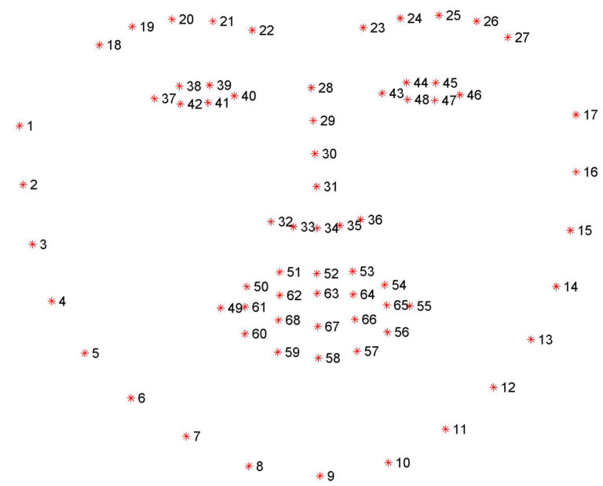
Facial Landmark Detection
Facial landmark prediction is the process of localizing key facial structures on a face, including the eyes, eyebrows, nose, mouth, and jawline.
Specifically, in the context of drowsiness detection, we only needed the eye regions and the lip region

Slide 7

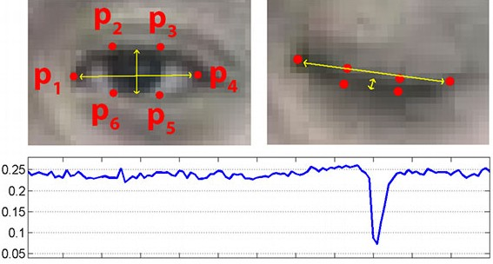
Eye Aspect Ratio
We can apply the eye aspect ratio to determine if the eyes are closed.
If the eyes have been closed for a sufficiently long enough period of time, we can assume the user is at risk of falling asleep and sound an alarm to grab their attention.

Slide 8
The Drowsiness Detector Algorithm
First, we’ll setup a camera that monitors a stream for faces.
If a face is found, we apply facial landmark detection and extract the eye and the lip regions.
Now that we have the eye regions, we can compute the eye aspect ratio to determine if the eyes are closed.
Also, we will compute the distance between inner lips to determine if the person is yawning.
If the eye aspect ratio indicates that the eyes have been closed for a sufficiently long enough amount of time, we’ll sound an alarm to wake up the driver
If the lip distance indicates that the person is yawning we’ll sound an alarm to take some fresh air.

Slide 9
Graphical User Interface(GUI)
We have created a GUI for our project to make the program user friendly and also so that it can be run on a android phone.
The GUI has 3 buttons:
  DETECT: To simply start detecting driver’s face and check if he is drowsy.
  TROUBLESHOOT THRESHOLDS: User can alter the EAR and Lip Distance thresholds using the toggle window provided.
  EXIT: To end the program without running it.

Slide 10
Softwares Used

Slide 11
Packages Required
opencv-python
kivy
kivy-examples
dlib
gTTs
imutils
numpy
playsound
scripy

